Slide 1
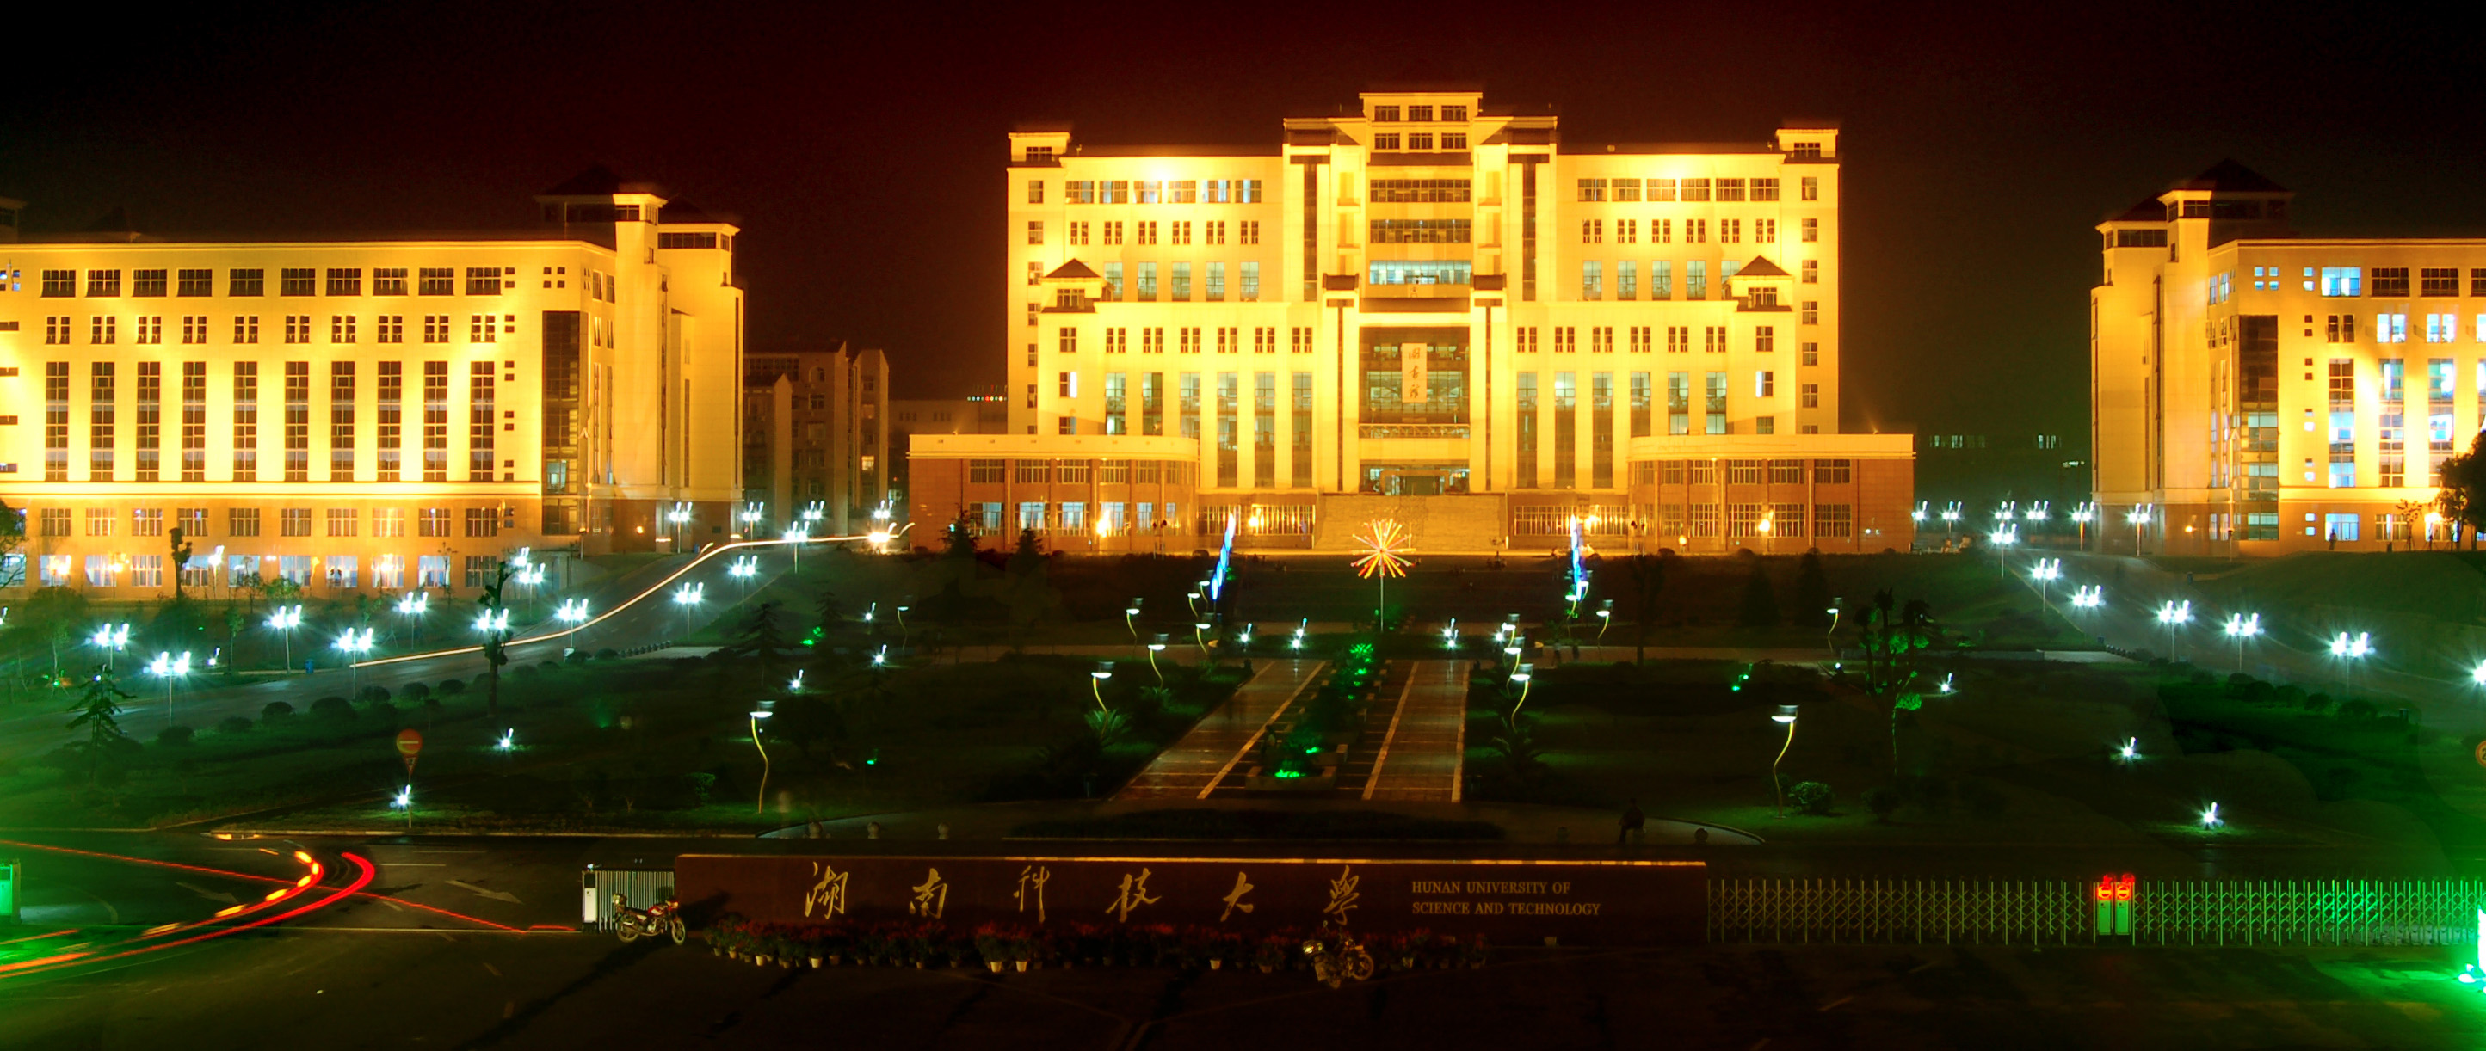

DESTINY
FREEDOM
湖南科技大学
And I've waited longer for you than I've waited for any woman.

Slide 2

Contents
1 - Click here to add your title
2 - Click here to add your title
3 - Click here to add your title
4 - Click here to add your title
5 - Click here to add your title

Slide 3
PART.01
Click here to add your title
I love you more than I've ever loved any woman. And I've waited longer for you than I've waited for any woman.
I love you more than I've ever loved any woman. And I've waited longer for you than I've waited for any woman.

Slide 4
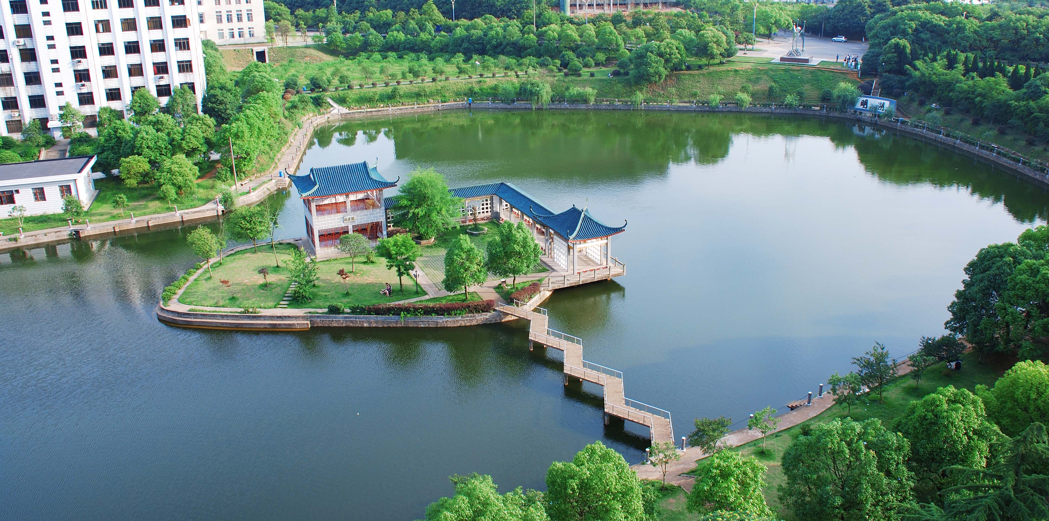
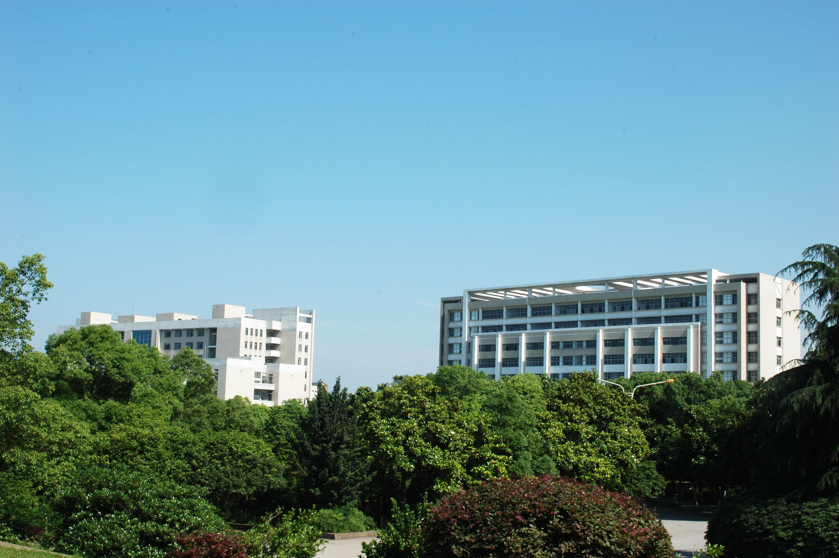
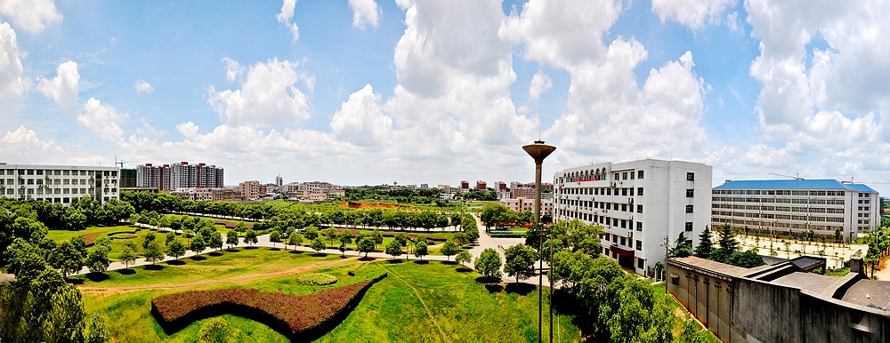
Click here to add your title
I love you more than I've ever loved any woman. And I've waited longer for you than I've waited for any woman.
I love you more than I've ever loved any woman. And I've waited longer for you than I've waited for any woman.I love you more than I've ever loved any woman. And I've waited longer for you than I've waited for any woman.
ALL OR NOTHING
NOW OR NEVER

Slide 5
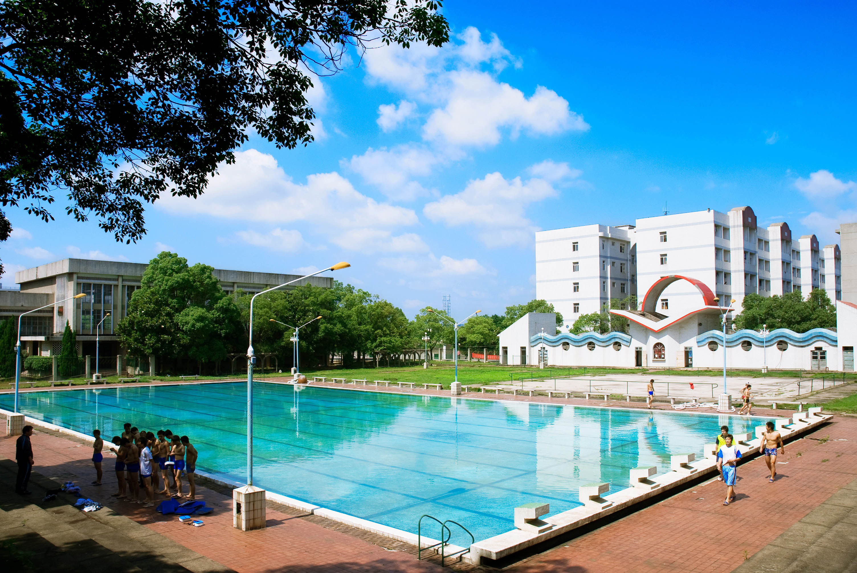
Click here to add your title
I love you more than I've ever loved any woman. And I've waited longer for you than I've waited for any woman.
I love you more than I've ever loved any woman. And I've waited longer for you than I've waited for any woman.I love you more than I've ever loved any woman. And I've waited longer for you than I've waited for any woman.
DESTINY FREEDOM

Slide 6
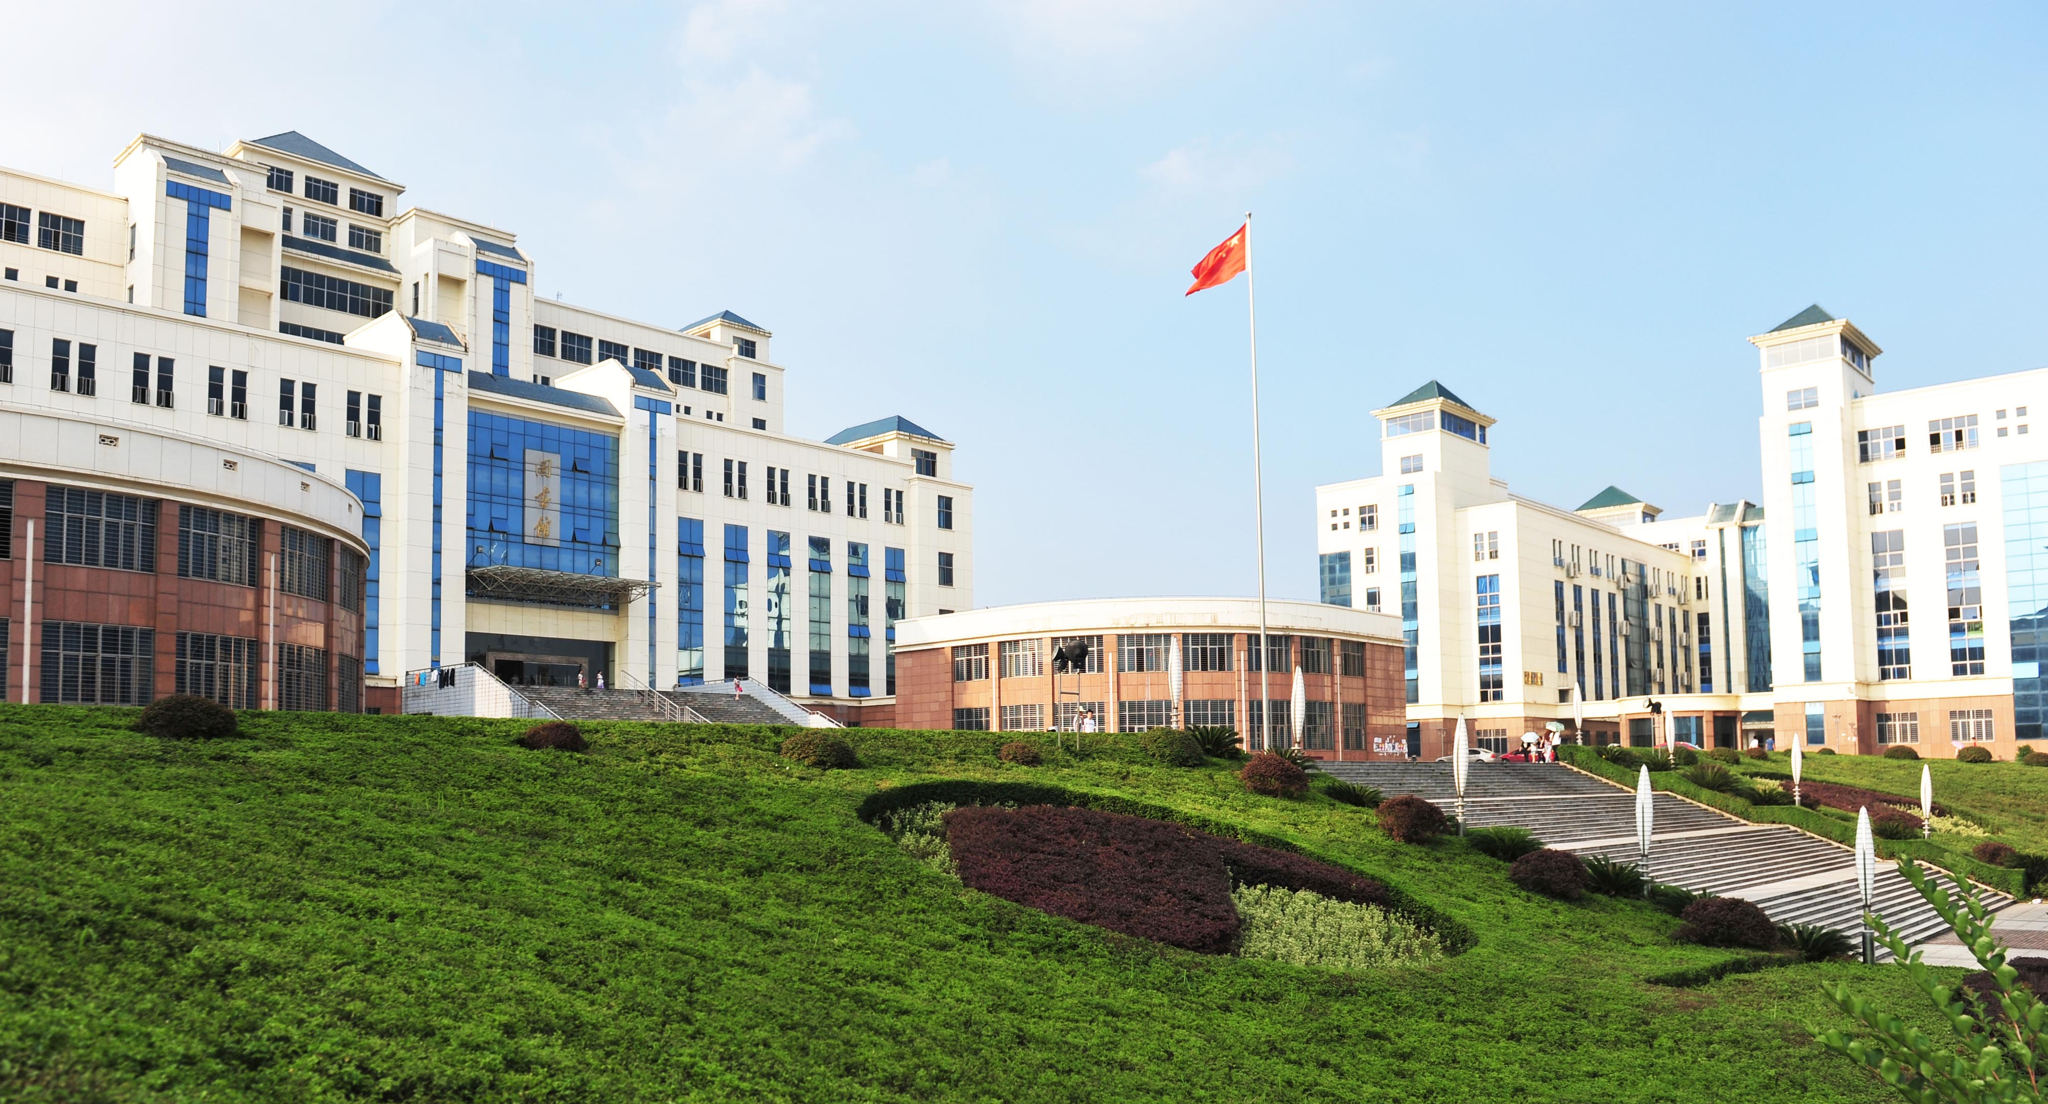
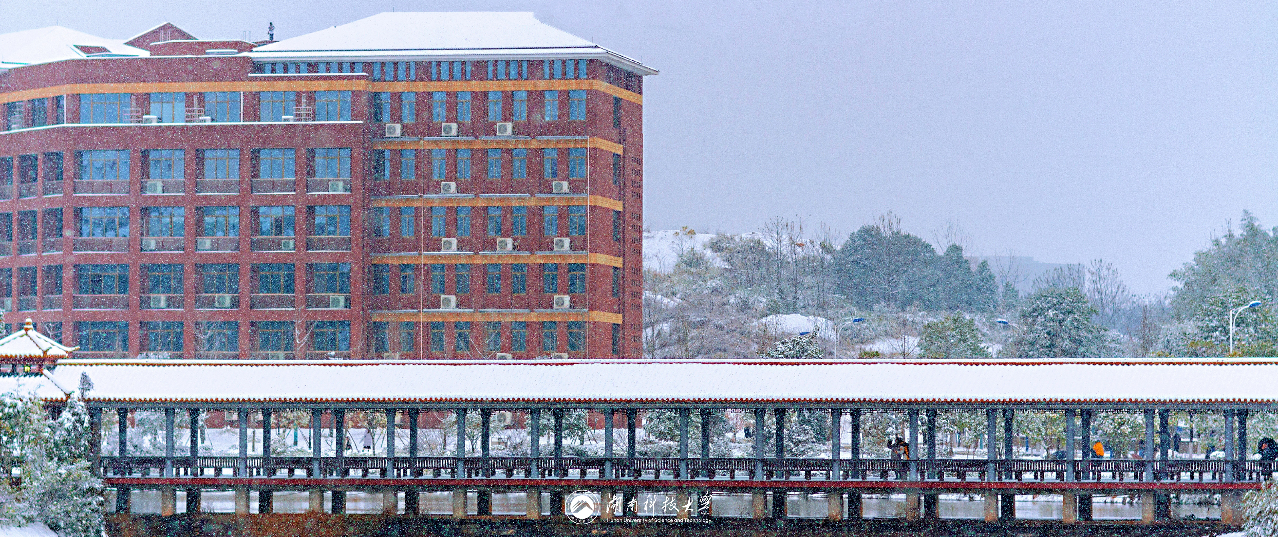
ALL OR NOTHING
NOW OR NEVER
DESTINY FREEDOM
I love you more than I've ever loved any woman. And I've waited longer for you than I've waited for any woman.
I love you more than I've ever loved any woman. And I've waited longer for you than I've waited for any woman.I love you more than I've ever loved any woman. And I've waited longer for you than I've waited for any woman.
I love you more than I've ever loved any woman. And I've waited longer for you than I've waited for any woman.

Slide 7
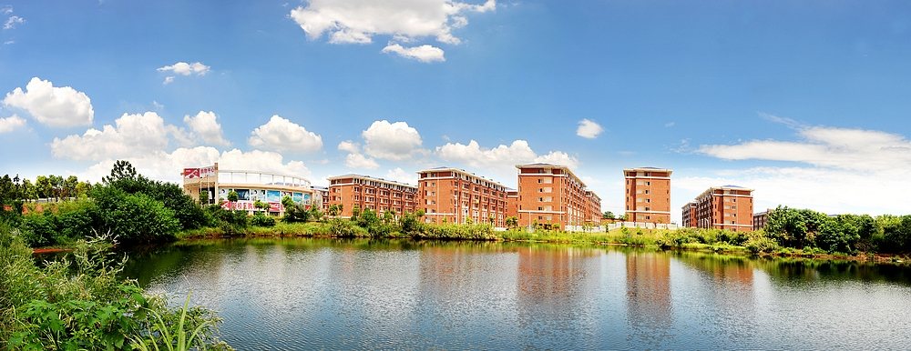
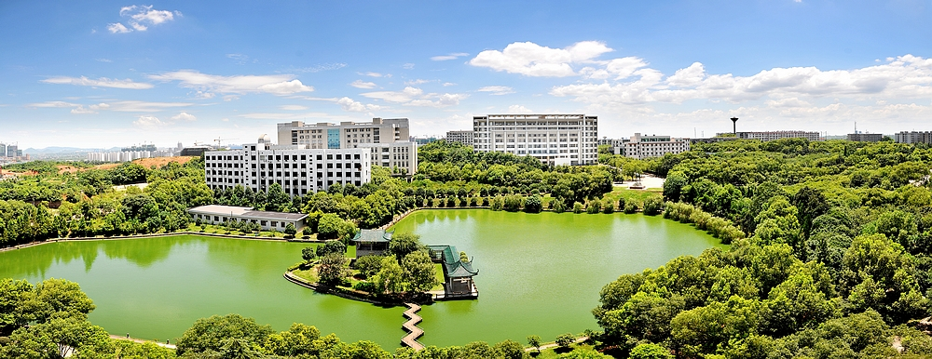
Click here to add your title
I love you more than I've ever loved any woman. And I've waited longer for you than I've waited for any woman.
I love you more than I've ever loved any woman. And I've waited longer for you than I've waited for any woman.I love you more than I've ever loved any woman. And I've waited longer for you than I've waited for any woman.
Click here to add your title
Click here to add your title
I love you more than I've ever loved any woman. And I've waited longer for you than I've waited for any woman.
I love you more than I've ever loved any woman. And I've waited longer for you than I've waited for any woman.

Slide 8
PART.02
Click here to add your title
I love you more than I've ever loved any woman. And I've waited longer for you than I've waited for any woman.
I love you more than I've ever loved any woman. And I've waited longer for you than I've waited for any woman.

Slide 9
Click here to add your title
And I've waited longer for you than I've waited for any woman.
DESTINY FREEDOM
DESTINY FREEDOM
DESTINY FREEDOM
I love you more than I've ever loved any woman. And I've waited longer for you than I've waited for any woman.
I love you more than I've ever loved any woman. And I've waited longer for you than I've waited for any woman.
I love you more than I've ever loved any woman. And I've waited longer for you than I've waited for any woman.
I love you more than I've ever loved any woman. And I've waited longer for you than I've waited for any woman.
I love you more than I've ever loved any woman. And I've waited longer for you than I've waited for any woman.
I love you more than I've ever loved any woman. And I've waited longer for you than I've waited for any woman.

Slide 10
Click here to add your title
I love you more than I've ever loved any woman. And I've waited longer for you than I've waited for any woman.
I love you more than I've ever loved any woman. And I've waited longer for you than I've waited for any woman.I love you more than I've ever loved any woman. And I've waited longer for you than I've waited for any woman.
I love you more than I've ever loved any woman. And I've waited longer for you than I've waited for any woman.

Slide 11

01
Click here to add your title
I love you more than I've ever loved any woman. And I've waited longer for you than I've waited for any woman.
02
Click here to add your title
I love you more than I've ever loved any woman. And I've waited longer for you than I've waited for any woman.
03
Click here to add your title
I love you more than I've ever loved any woman. And I've waited longer for you than I've waited for any woman.

Slide 12

Click here to add your title
I love you more than I've ever loved any woman. And I've waited longer for you than I've waited for any woman.
I love you more than I've ever loved any woman. And I've waited longer for you than I've waited for any woman.I love you more than I've ever loved any woman. And I've waited longer for you than I've waited for any woman.
I love you more than I've ever loved any woman. And I've waited longer for you than I've waited for any woman.

Slide 13

ALL OR
NOTHING
NOW OR NEVER
DESTINY FREEDOM
I love you more than I've ever loved any woman. And I've waited longer for you than I've waited for any woman.
I love you more than I've ever loved any woman. And I've waited longer for you than I've waited for any woman.
I love you more than I've ever loved any woman. And I've waited longer for you than I've waited for any woman.
I love you more than I've ever loved any woman. And I've waited longer for you than I've waited for any woman.

Slide 14
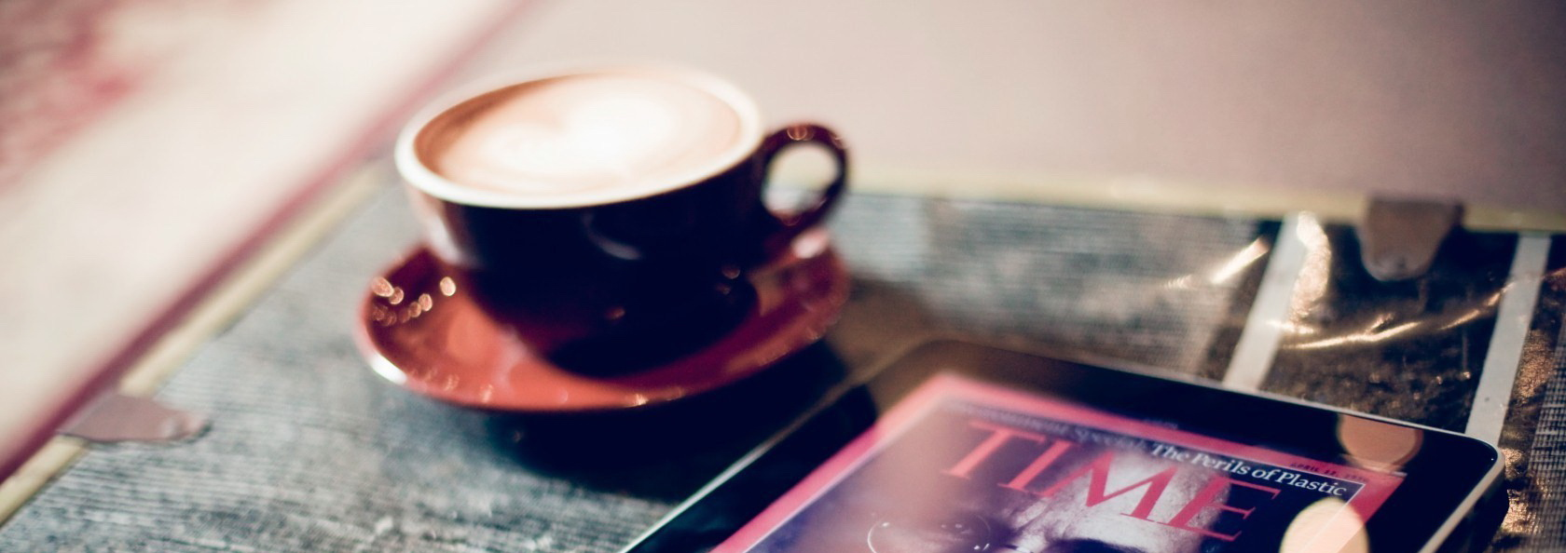
PART.03
Click here to add your title
I love you more than I've ever loved any woman. And I've waited longer for you than I've waited for any woman.
I love you more than I've ever loved any woman. And I've waited longer for you than I've waited for any woman.

Slide 15
ALL OR
NOTHING
NOW OR NEVER
I love you more than I've ever loved any woman. And I've waited longer for you than I've waited for any woman.
I love you more than I've ever loved any woman. And I've waited longer for you than I've waited for any woman.I love you more than I've ever loved any woman. And I've waited longer for you than I've waited for any woman.
Click here to add your title
I love you more than I've ever loved any woman. And I've waited longer for you than I've waited for any woman.

Slide 16
S
Click here to add
your title
I love you more than I've ever loved any woman. And I've waited longer for you than I've waited for any woman.I love you more than I've ever loved any woman.
I love you more than I've ever loved any woman. And I've waited longer for you than I've waited for any woman.I love you more than I've ever loved any woman.
I love you more than I've ever loved any woman. And I've waited longer for you than I've waited for any woman.I love you more than I've ever loved any woman.

Slide 17
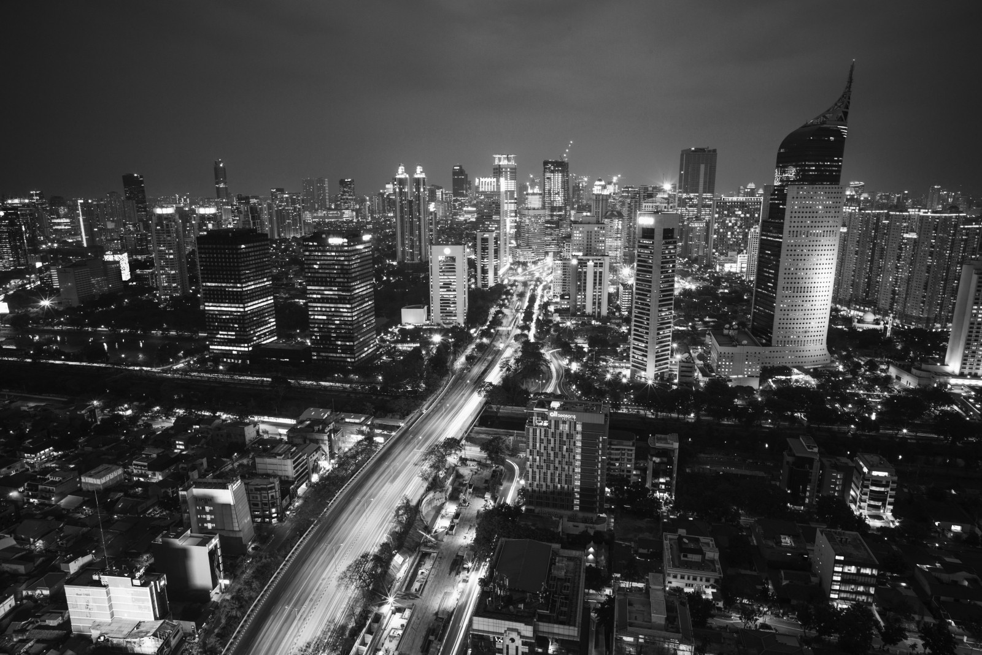
W
Click here to add
your title
I love you more than I've ever loved any woman. And I've waited longer for you than I've waited for any woman.I love you more than I've ever loved any woman.
I love you more than I've ever loved any woman. And I've waited longer for you than I've waited for any woman.I love you more than I've ever loved any woman.
I love you more than I've ever loved any woman. And I've waited longer for you than I've waited for any woman.I love you more than I've ever loved any woman.

Slide 18

O
Click here to add
your title
I love you more than I've ever loved any woman. And I've waited longer for you than I've waited for any woman.I love you more than I've ever loved any woman.
I love you more than I've ever loved any woman. And I've waited longer for you than I've waited for any woman.I love you more than I've ever loved any woman.
I love you more than I've ever loved any woman. And I've waited longer for you than I've waited for any woman.I love you more than I've ever loved any woman.

Slide 19
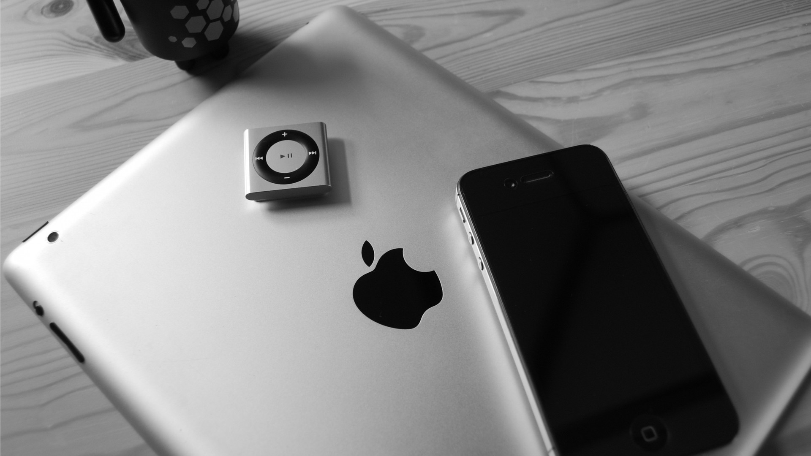
T
Click here to add
your title
I love you more than I've ever loved any woman. And I've waited longer for you than I've waited for any woman.I love you more than I've ever loved any woman.
I love you more than I've ever loved any woman. And I've waited longer for you than I've waited for any woman.I love you more than I've ever loved any woman.
I love you more than I've ever loved any woman. And I've waited longer for you than I've waited for any woman.I love you more than I've ever loved any woman.

Slide 20
PART.04
Click here to add your title
I love you more than I've ever loved any woman. And I've waited longer for you than I've waited for any woman.
I love you more than I've ever loved any woman. And I've waited longer for you than I've waited for any woman.

Slide 21



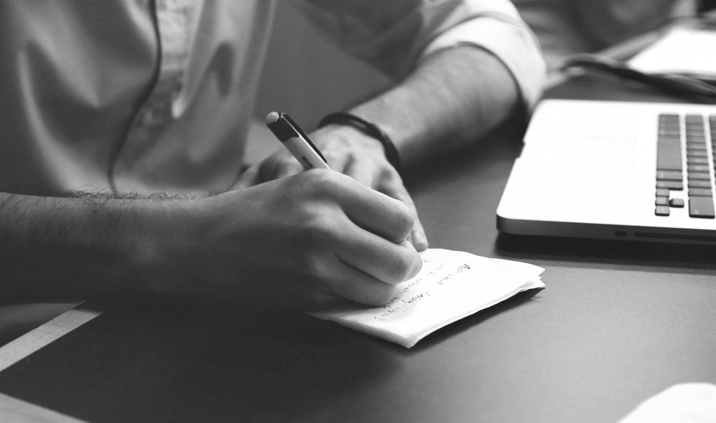

Click here to add your title
I love you more than I've ever loved any woman. And I've waited longer for you than I've waited for any woman.I love you more than I've ever loved any woman. And I've waited longer for you than I've waited for any woman.
I love you more than I've ever loved any woman. And I've waited longer for you than I've waited for any woman.

Slide 22
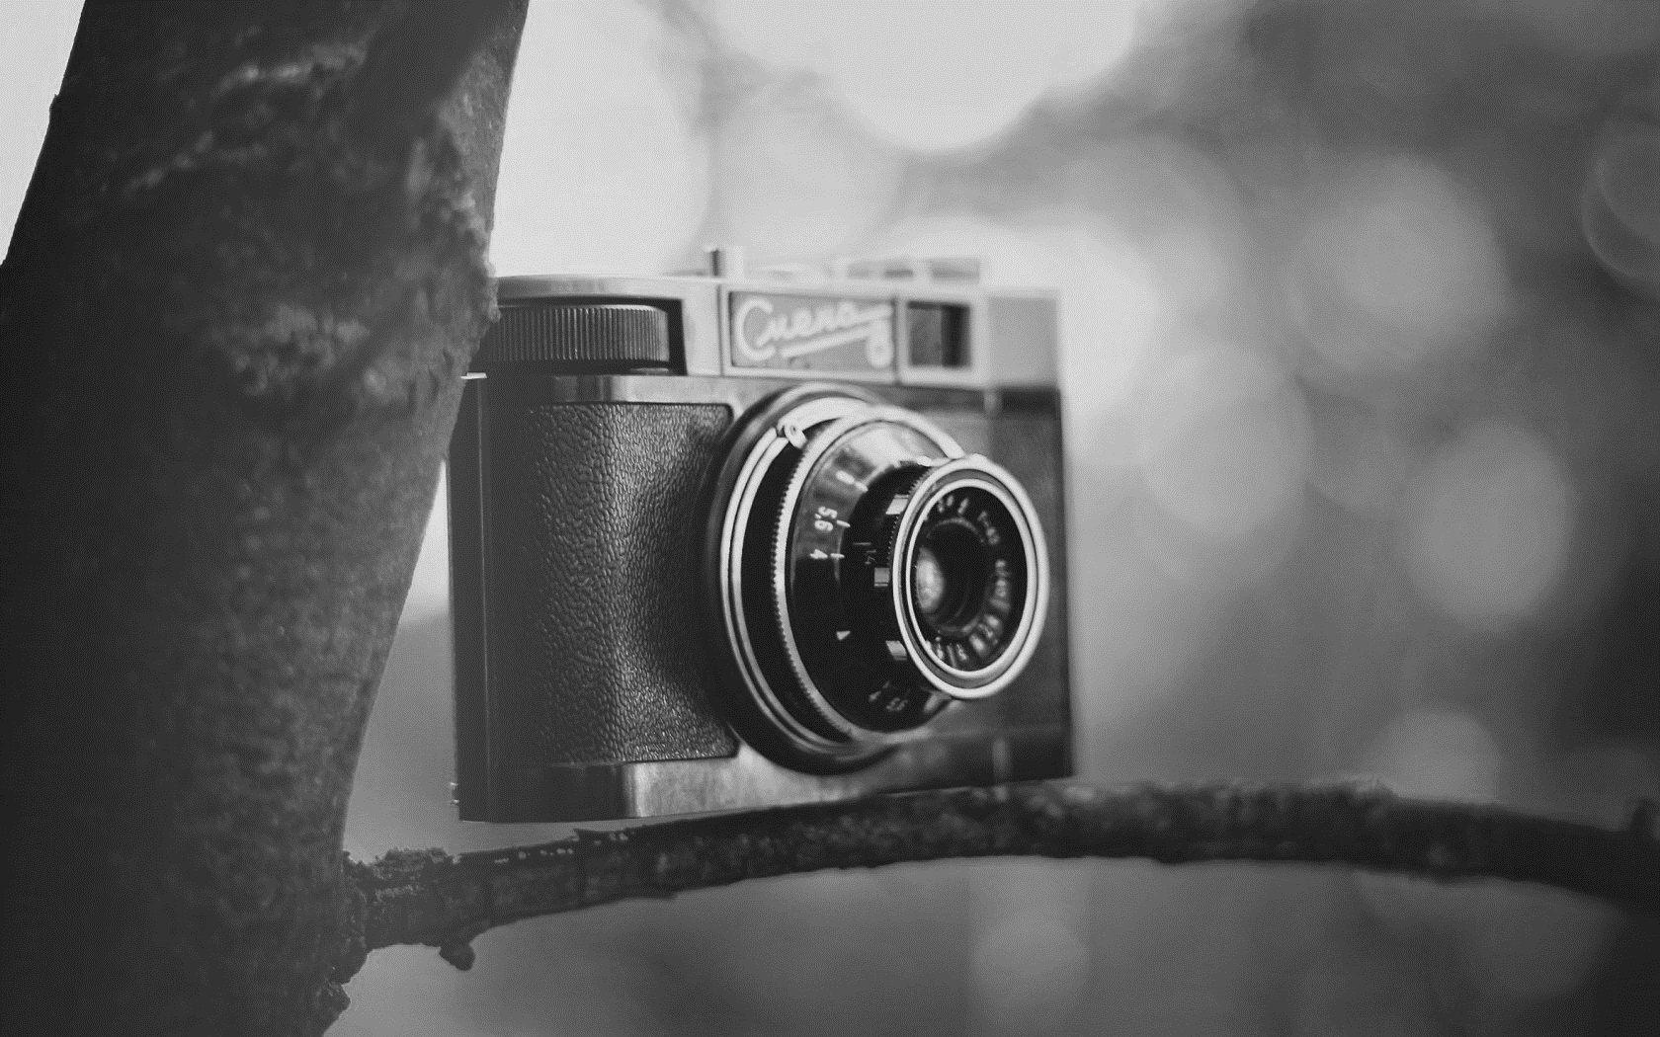

Click here to add your title
I love you more than I've ever loved any woman. And I've waited longer for you than I've waited for any woman.
I love you more than I've ever loved any woman. And I've waited longer for you than I've waited for any woman.
Click here to add your title
I love you more than I've ever loved any woman. And I've waited longer for you than I've waited for any woman.
I love you more than I've ever loved any woman. And I've waited longer for you than I've waited for any woman.

Slide 23
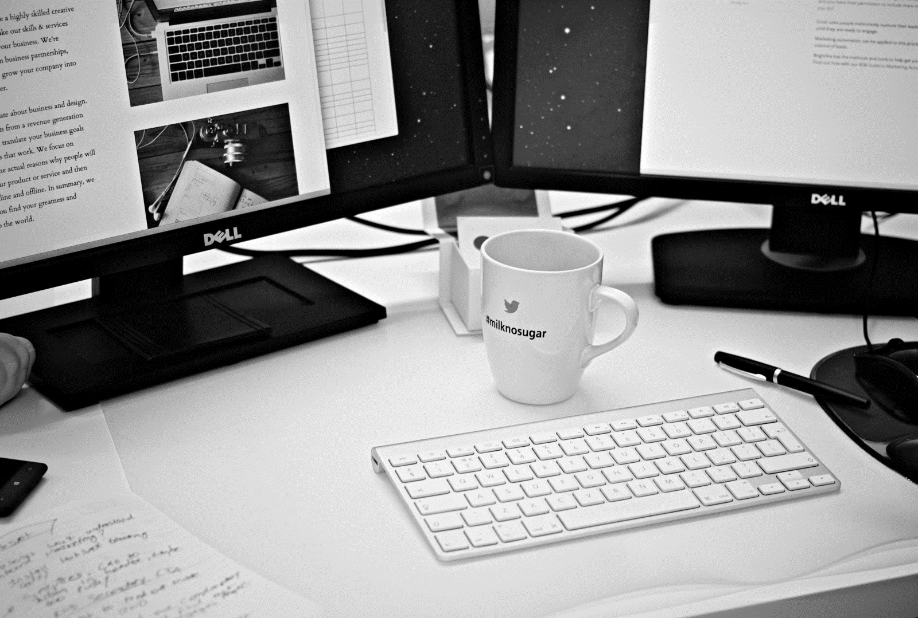
Click here to add your title
I love you more than I've ever loved any woman. And I've waited longer for you than I've waited for any woman.
I love you more than I've ever loved any woman. And I've waited longer for you than I've waited for any woman.I love you more than I've ever loved any woman. And I've waited longer for you than I've waited for any woman.

Slide 24
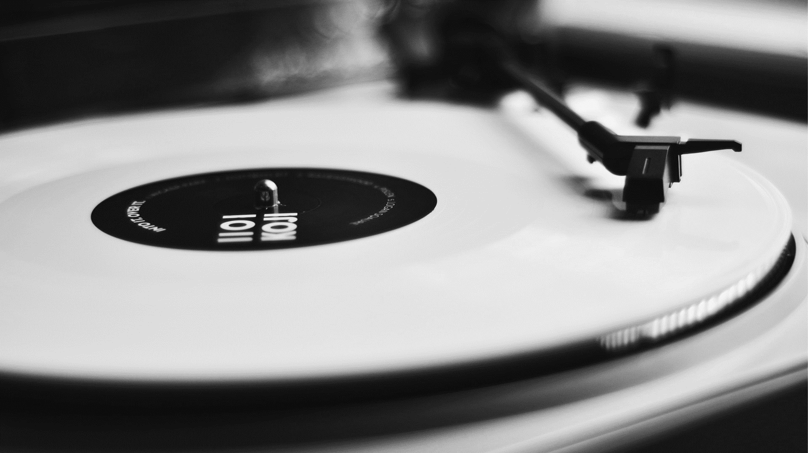

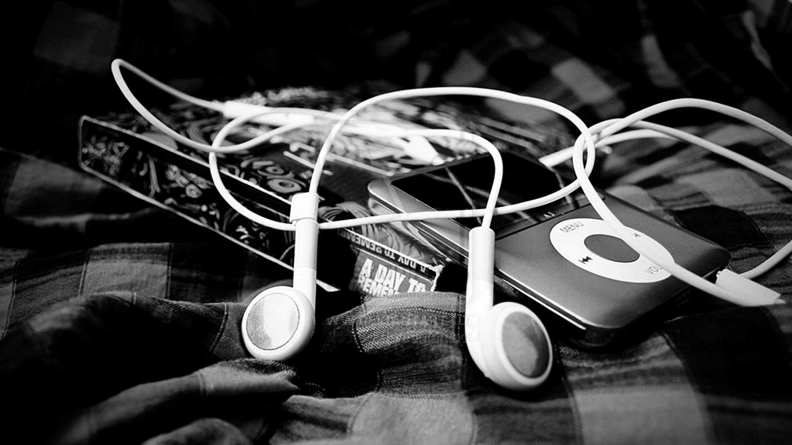
DESTINY FREEDOM
DESTINY FREEDOM
DESTINY FREEDOM
I love you more than I've ever loved any woman. And I've waited longer for you than I've waited for any woman.
I love you more than I've ever loved any woman. And I've waited longer for you than I've waited for any woman.
I love you more than I've ever loved any woman. And I've waited longer for you than I've waited for any woman.

Slide 25
THE
END
THANK YOU
And I've waited longer for you than I've waited for any woman.

